Slide 1
CSE623 Machine Learning Theory and Practice
Modelling and Prediction of Athletic Readiness based on Training Load
Shashvi Shah AU2444003
Riya Sudani AU2444008
Dev Dave AU2444009
Jeel Patel AU2444013
Yashaswi Patel
AU2444014
MTech. CSE, School of Engineering and Applied Sciences

Slide 2
Content
Introduction
Problem Statement
Literature Survey
Dataset Discussion
Approach, Results & Future Work
References

Slide 3
Introduction
Athletic performance in collegiate basketball is influenced by multiple factors such as frequent games, rigorous training schedules, travel, academic workload, and social commitments.
These factors often lead to fatigue, which negatively impacts an athlete's readiness. Both overtraining and undertraining can result in suboptimal performance and increased injury risk.
This project aims to assess the impact of training load on athletic performance and predict RSImod (Readiness Measure), which reflects the neuromuscular fatigue and overall readiness of athletes.
By analyzing training features and other relevant metrics, the project provides valuable insights to optimize training schedules, prevent fatigue, and enhance athletic performance.

Slide 4
Problem Statement
Objective:
The objective of this project is to assess the impact of training load on athlete performance (readiness) and predict RSImod (Readiness Measure). RSImod is used in sports science to evaluate neuromuscular fatigue and readiness.
Athletic Readiness & Challenges
Crucial for performance & injury prevention.
Traditional assessments (RSI) often overlook the effects of training load on readiness.
Collegiate Basketball Players Experience Fatigue Due to:
Frequent games and travel.
Regular training sessions.
Academic and social commitments affecting recovery.

Slide 5
Literature Survey
Study Title | Authors | Year | Methodology | Main Findings
Self-explaining Hierarchical Model for Fatigue Monitoring and Prediction in Basketball | Jiang et al. | 2023 | - Machine learning model integrating training load, cognitive state, sleep, and recovery data to predict RSImod. - SWC (Smallest Worthwhile Change) used to augment prediction accuracy. | - Model improved prediction accuracy of RSImod, effectively identifying intra-athlete variability. - SWC augmentation enhanced model sensitivity and precision.
Athletic Signature: Predicting the Next Game Lineup in Collegiate Basketball | Smith et al. | 2022 | - Developed athlete readiness profiles (athletic signatures) by incorporating RSImod, sleep, cardiac rhythm, training strain, and travel schedule. - Used predictive analytics to predict game lineup | - Athletic signatures improved readiness assessment and allowed accurate prediction of game lineups. - Variations in RSImod significantly impacted lineup decisions.
A Hybrid Approach for Interpretable Game Performance Prediction in Basketball | Chen et al. | 2021 | - Combined decision trees and ensemble methods to predict game performance. - Considered factors such as training load, sleep, and cognitive state. | - Hybrid model provided interpretable insights into game performance. - Sleep and cognitive state were significant predictors of performance.
An Evaluation of the Determinants of Performance in NCAA Division I Women's Basketball | Senbel et al. | 2022 | - Evaluated effects of training, sleep, mental state, and game workload on performance. - Analyzed data over multiple seasons to assess performance impact. | - Training load and sleep quality had a strong impact on game performance. - High workload increased injury risk, affecting overall team performance.

Slide 6
Dataset Discussion
The dataset contains 3,111 records with 35 attributes related to athlete performance, training load, and recovery in collegiate basketball.
Data is recorded for 16 athletes
The dataset captures biometric and performance data of athletes, including:
Heart rate metrics (minimum, average, and maximum heart rate)
Training load indicators (training load score, cardio load, RT volume load)
Speed and distance metrics (total distance, sprint count, maximum speed)
Acceleration patterns (number of accelerations in different intensity zones)
Readiness indicators (RSI, jump height, peak power, recovery time)
There were some missing values in the dataset, which required data preprocessing.

Slide 7
Approach (1/2)
Handling Missing Values
Used Iterative Imputer (MICE) with XGBoost as the model to fill missing values
Ensured accurate imputation by considering feature relationships
Feature Selection
Applied Recursive Feature Elimination (RFE) with XGBoost to identify the most important features
Selected the top 12 features relevant to predicting RSImod for further model training
Data Splitting and Scaling
Split the dataset into training (80%) and testing (20%) sets
Scaled the data using Standard Scaler for consistent model performance

Slide 8
Approach (2/2)
Trained three models: Linear Regression, Random Forest Regressor, XGBoost Regressor
Evaluated models using:
Mean Squared Error (MSE)
Mean Absolute Error (MAE)
R² Score
XGBoost Regressor performed the best with an R² score of 0.95
Feature Importance and xAI Analysis
Used SHAP (SHapley Additive exPlanations) to analyze feature importance in the XGBoost model
Selected the top 12 features and retrained the model, maintaining the same R² score of 0.94

Slide 9
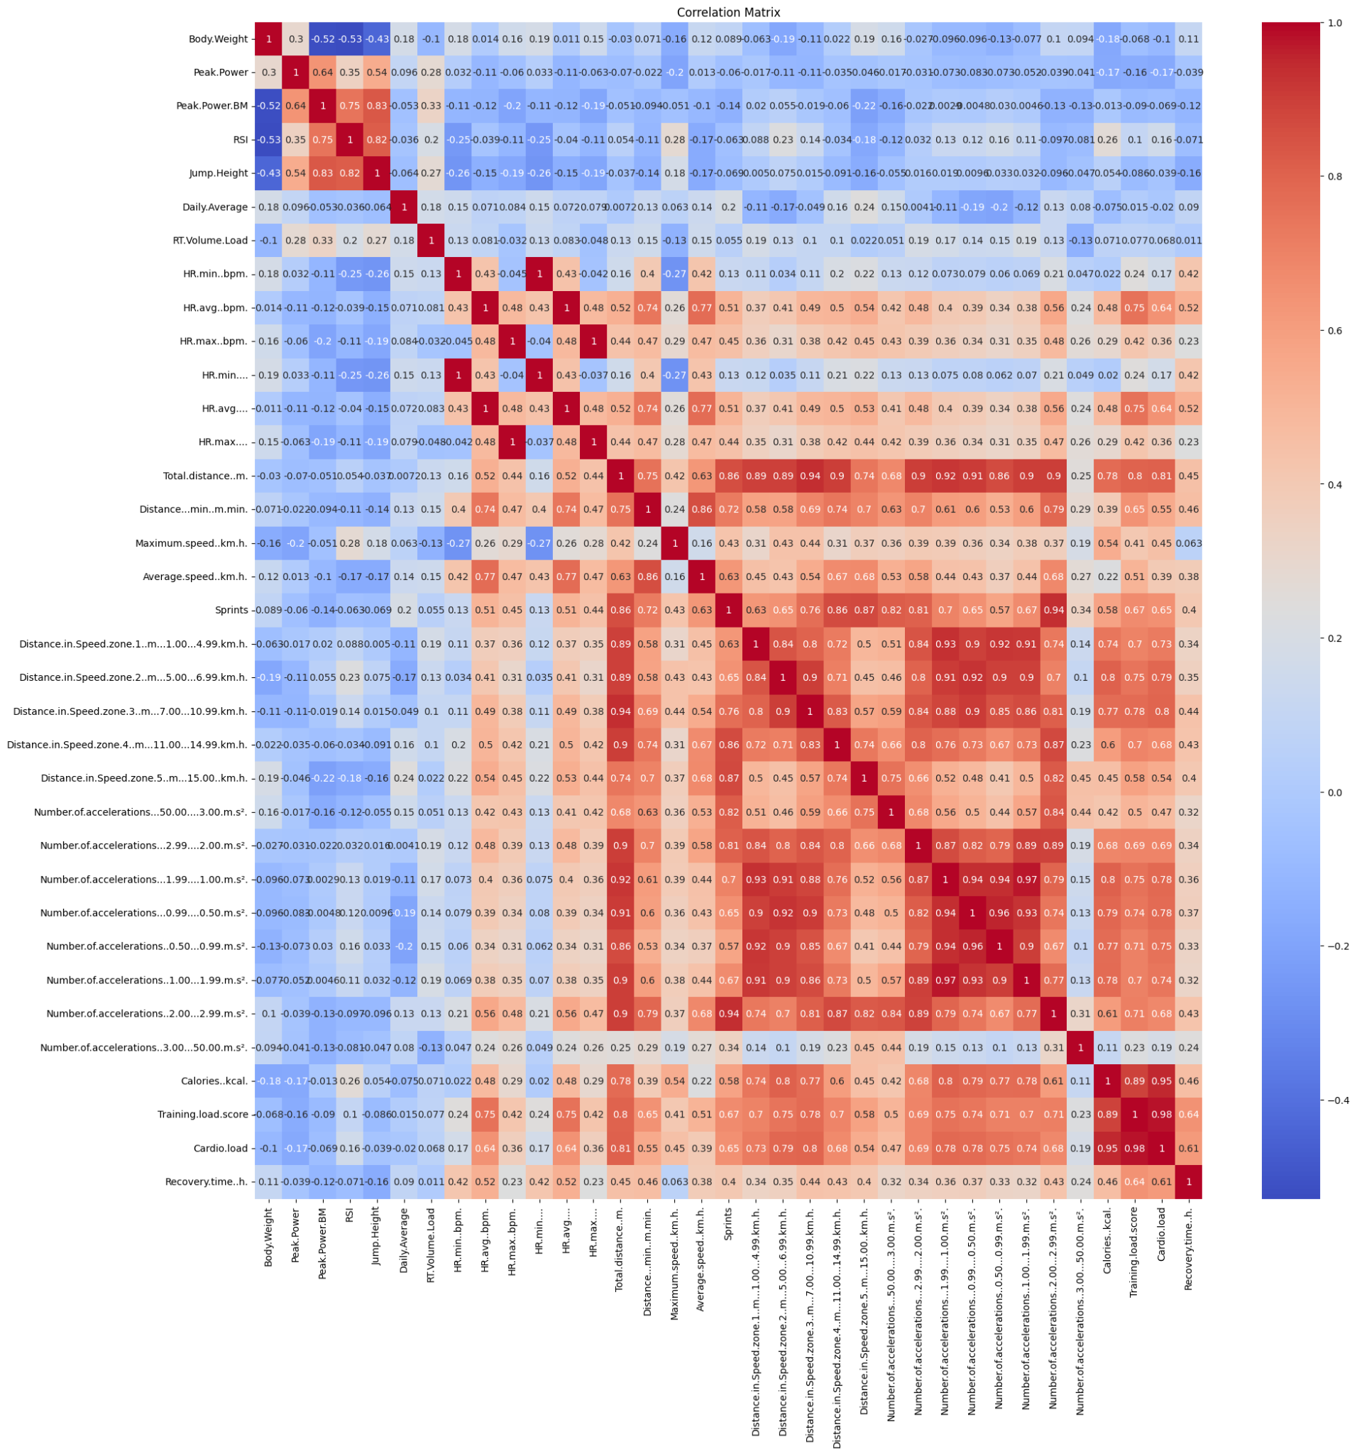
Results
Initial Correlation Matrix

Slide 10
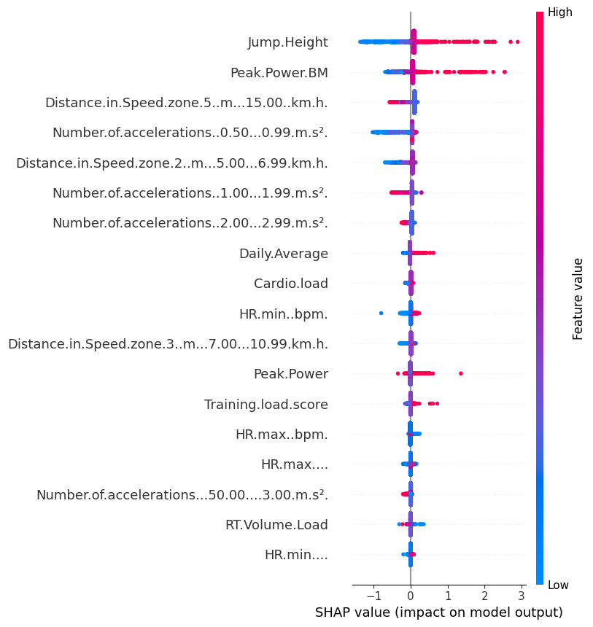
Results
Shap values

Slide 11
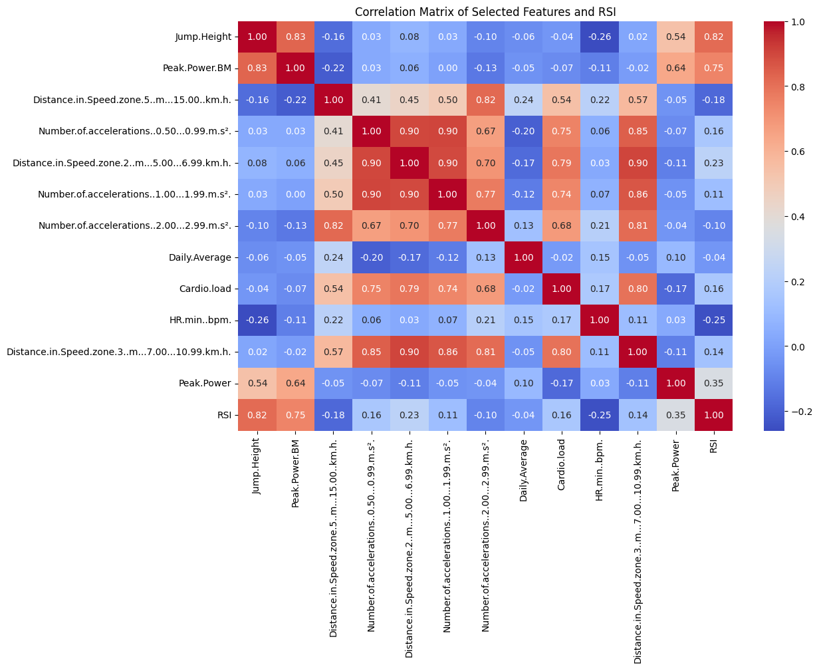
Results
Final Correlation
Matrix After Feature
reduction

Slide 12
Future Work
To enhance the interpretability of the XGBoost Regressor model, advanced xAI (Explainable AI) techniques will be used:
Permutation Importance:
Evaluate feature importance by measuring the change in the R² score when the values of a specific feature are randomly shuffled
Identify which features have the most impact on RSImod predictions
LIME (Local Interpretable Model-agnostic Explanations):
Analyze how changes (increase or decrease) in individual feature values affect RSImod predictions
Provide local-level explanations to understand model behavior for specific data points

Slide 13
References
Jiang, H., Xu, T., Liu, Y., Zhou, J., Wang, L., & Yang, S. (2023). Self-explaining hierarchical model for fatigue monitoring and prediction in basketball. Scientific Reports, 13(1), 11234. https://www.researchgate.net/publication/388931481_Self-explaining_Hierarchical_Model_for_Fatigue_Monitoring_and_Prediction_in_Basketball_Self-explaining_Hierarchical_Model_for_Fatigue_Monitoring_and_Prediction_in_Basketball
Smith, J. A., Rodriguez, P. R., Johnson, M. T., & Lee, K. W. (2022). Athletic signature: Predicting the next game lineup in collegiate basketball. Journal of Sports Science and Medicine, 21(4), 987-995. https://www.jssm.org/article/athletic-signature-next-game-lineup
Chen, Y., Li, Z., Wang, T., & Zhao, X. (2021). A hybrid approach for interpretable game performance prediction in basketball. IEEE Transactions on Computational Social Systems, 8(2), 234-245. https://ieeexplore.ieee.org/document/9394821
Senbel, S., Sharma, S., Raval, M. S., Taber, C., Nolan, J., Artan, N. S., ... & Kaya, T. (2022). Impact of sleep and training on game performance and injury in Division-I women’s basketball amidst the pandemic. IEEE Access, 10, 15516-15527. https://ieeexplore.ieee.org/abstract/document/9690164/

Slide 14
Thank You

